Slide 1

How Socio-demographic factors influence health?
Vineetha Dulla and Harshavardhan Chittaluru

Slide 2
YEAR - 1972 to 2018
WRKSTAT - full time, part time, retired, house keeping, not working, unemployed, school, others
MARITAL - married, widowed, unmarried, divorced,
separated
AGE - 18 to 99 years
EDUC - 0 to 20
SEX - male, female
RINCOME - <$1000 to >$25000
REGION - New England, middle Atlantic, north central, south central, mountain, pacific, south Atlantic
NATDRUG - too little, about right , too much
HEALTH - excellent, good, fair, poor
HAPPY - very happy , pretty happy , not too happy
SMOKE – yes, no
RACE – white, black, others
GSS DataSet
64814,13

Slide 3
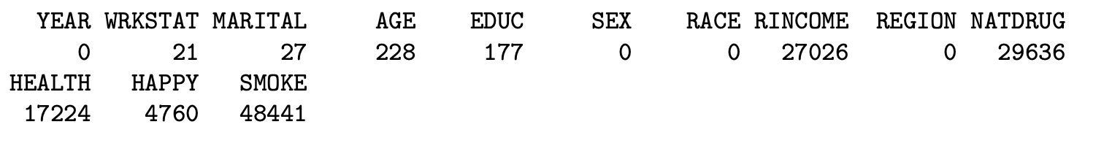
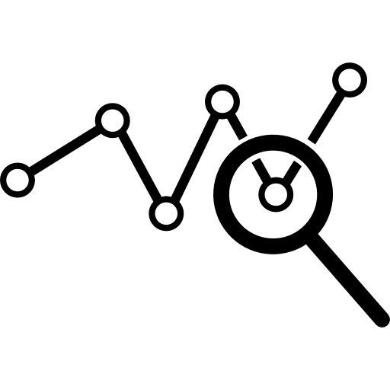
Initial Data Analysis:
We find out the count of NA values in each feature.
Given a thought to remove NA values in each feature, surprisingly the count of remaining data set is 3314.
Here comes out first preprocessing step of remaining all NA values to build a complete data set.
It’s shape
Depletion rate for complete data set is 95%.
3314,13

Slide 4
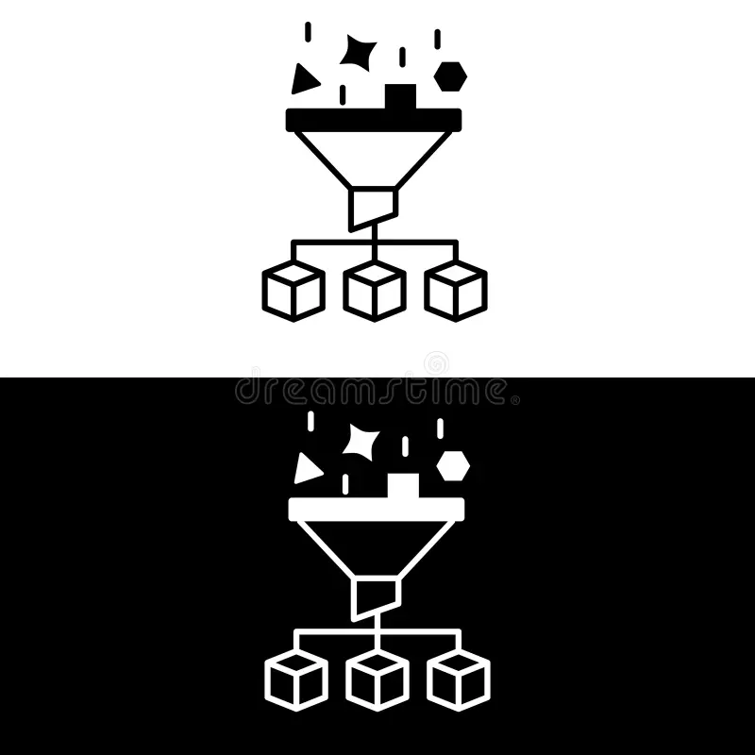
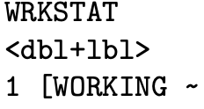
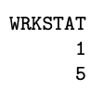
Data Pre-processing
Our main pre-processing goal is to remove NA values.
Initially we have <dbl +lbl> data type i.e., double and label, we removed label from the data set.
We used mice imputting method to replace NA values using random forest method.
Syntax:
To get 5 different data sets, we used complete() function.
Syntax:

Slide 5
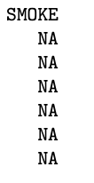
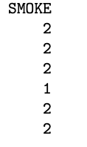

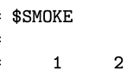
We take unique values from each feature and then we replace NA values of that particular feature by selecting a random value from the unique values.
Catalyst = effort
Finally, after successful preprocessing we got 7 different datasets.
gss_data_wo_na – Data set without NA values
gss_data_rf_1
gss_data_rf_2
gss_data_rf_3 Data set from mice imputation method
gss_data_rf_4
gss_data_rf_5
gss_data_rvalues – Data set with random values

Slide 6
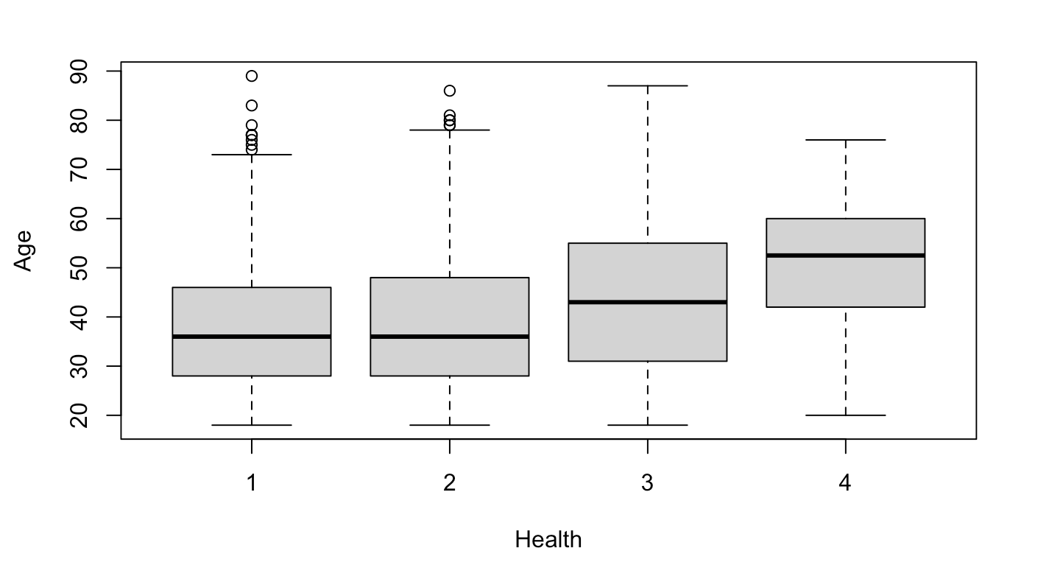
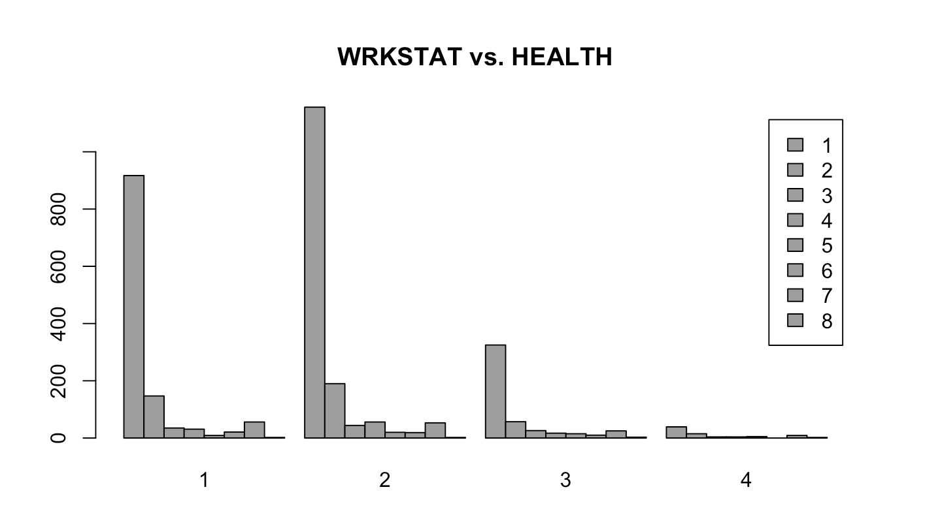
Exploratory Data Analysis:

Slide 7
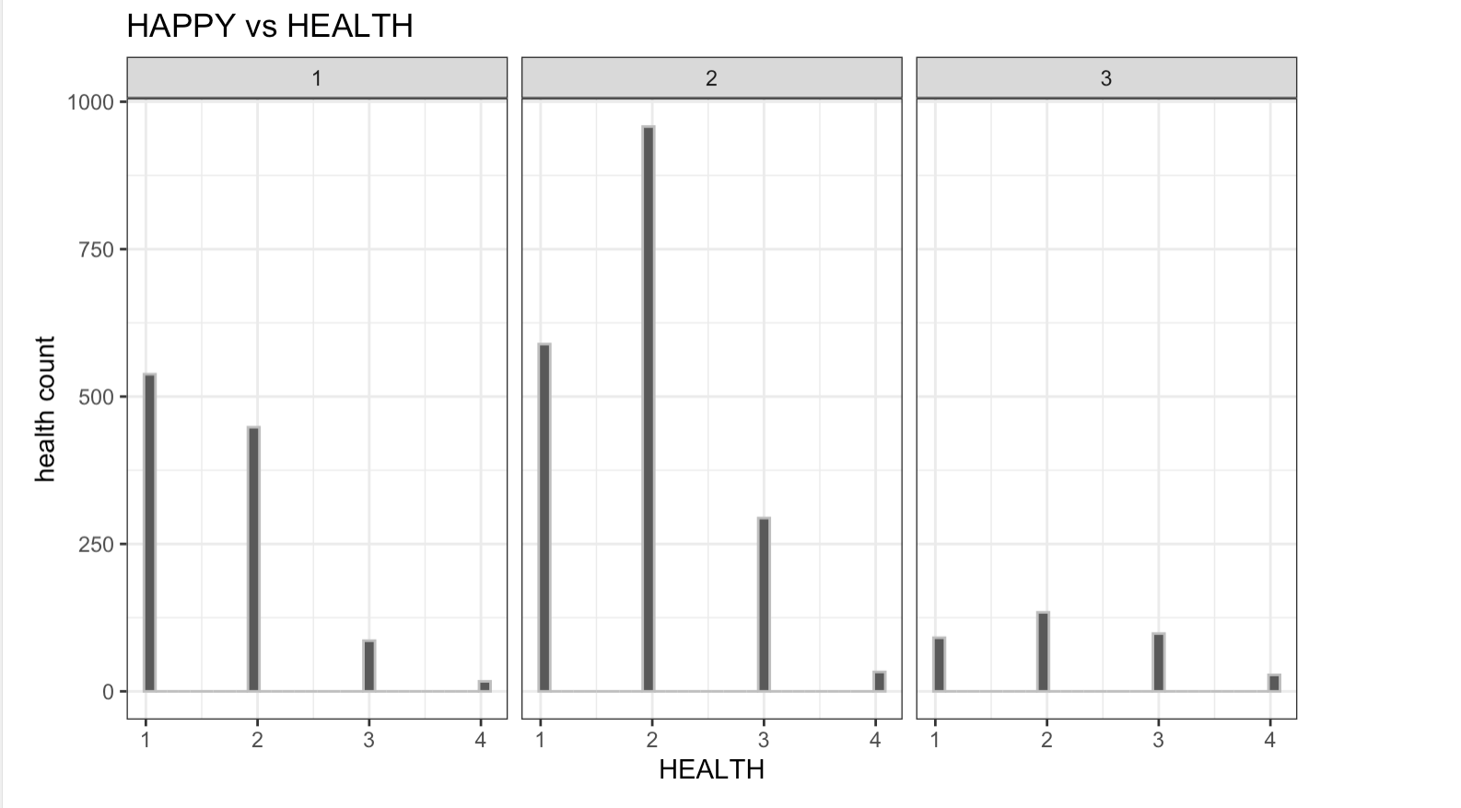
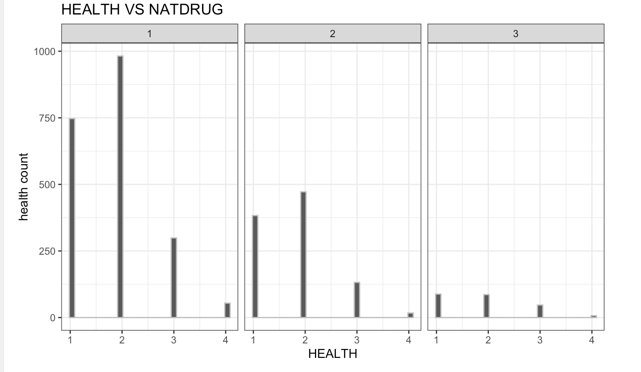

Slide 8
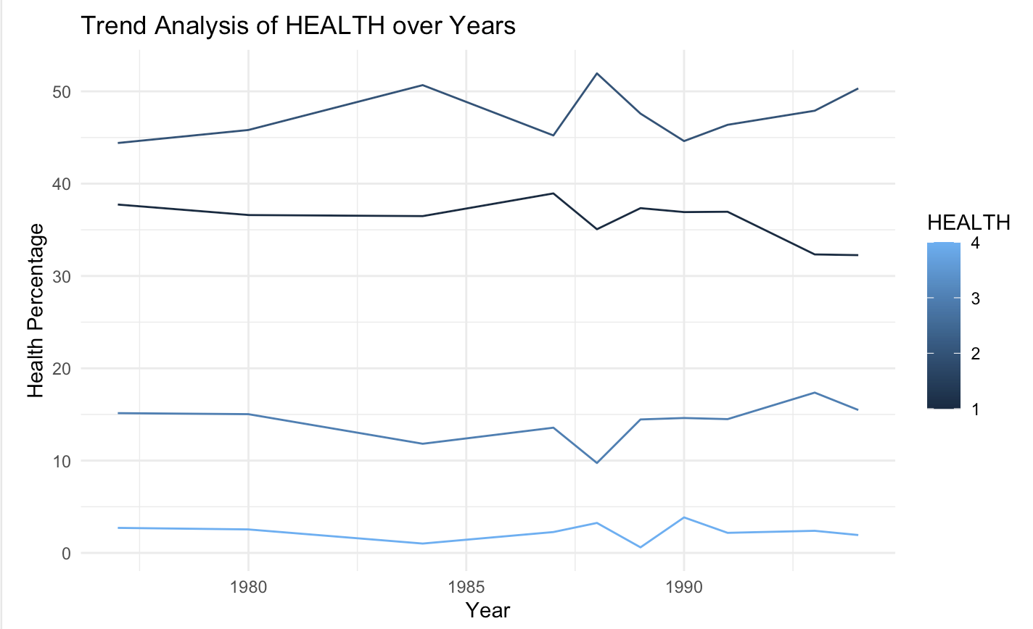
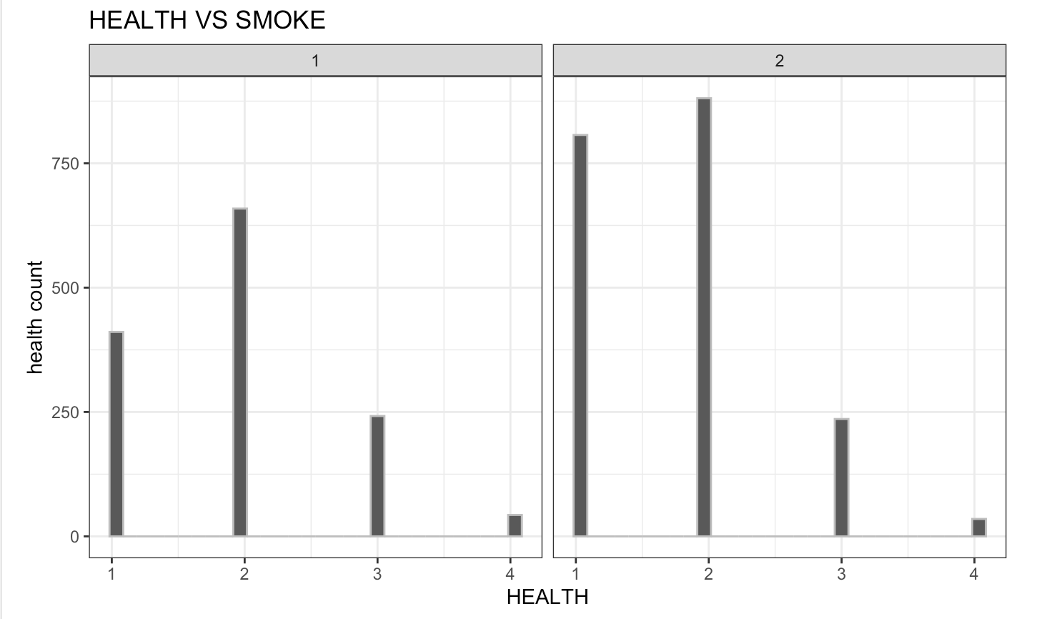

Slide 9
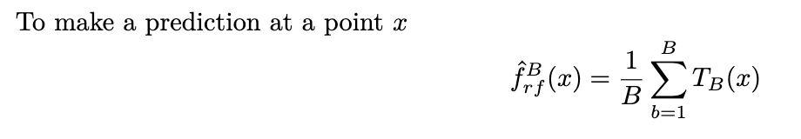

Random Forest
Random Forest approach is a supervised learning algorithm. It builds the multiple decision trees which are known as forest and glue them together to urge a more accurate and stable prediction.
Bagging
Bagging, also known as bootstrap aggregation, is the ensemble learning method that is commonly used to reduce variance within a noisy dataset.
Random forest follows the Bagging technique.

Slide 10

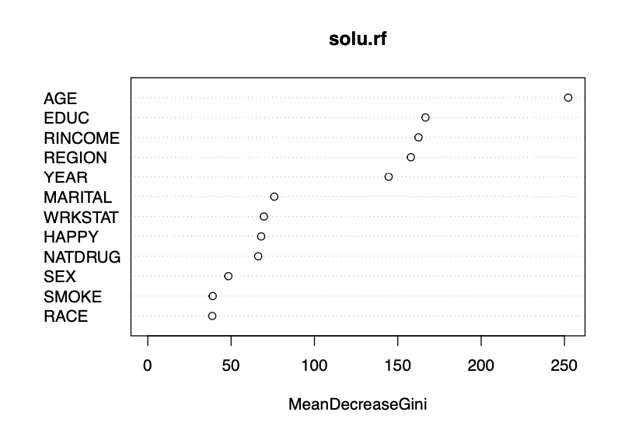
Importance Plot:
AGE is the important feature out of all the features. Which is why I compare the HEALTH variable with AGE for the plots associated with Random Forest.

Slide 11
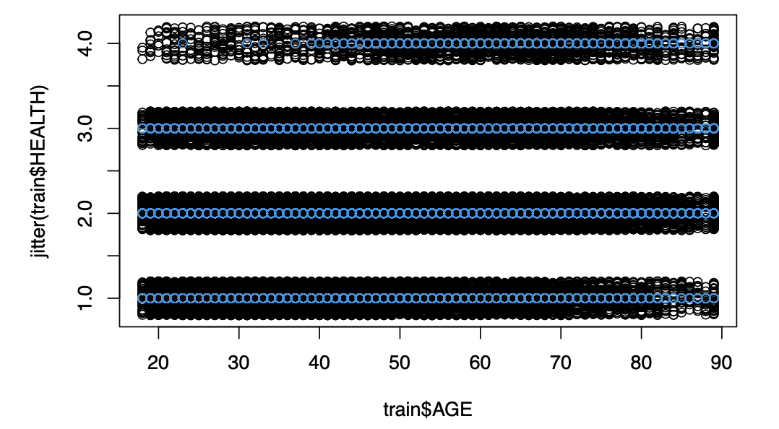
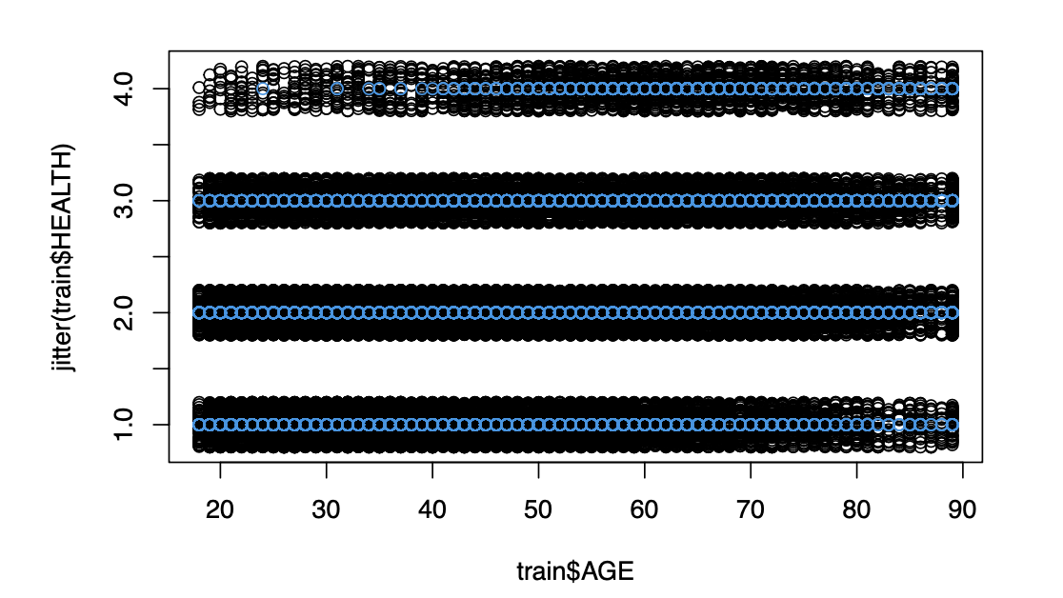
Our Model
We train this model with all 7 data sets and we get the following graphs
1st Mice model
2nd Mice model

Slide 12
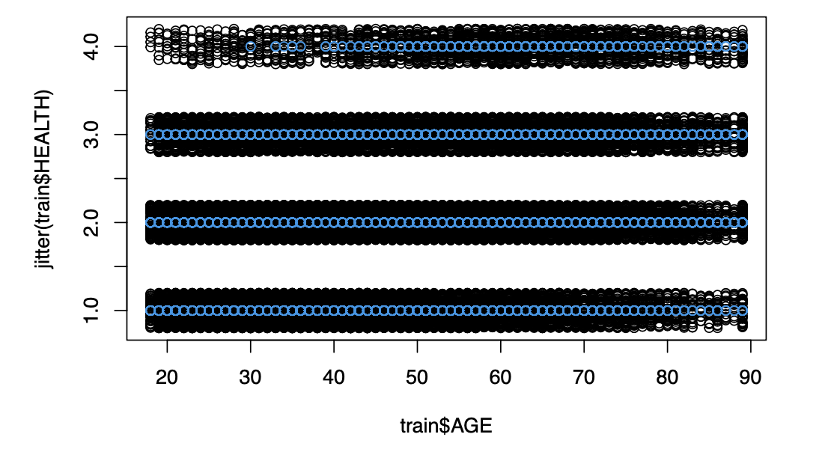
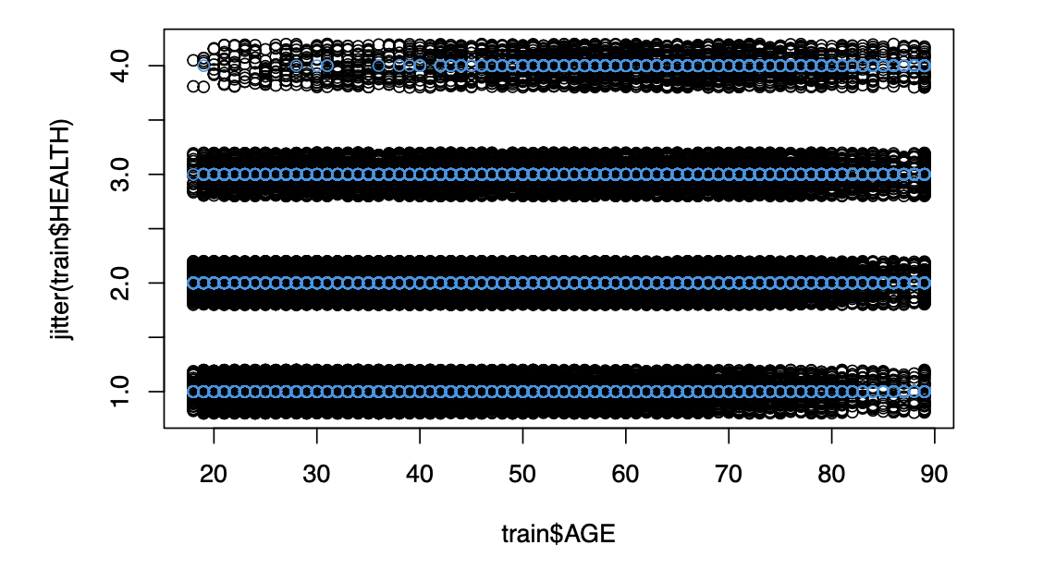
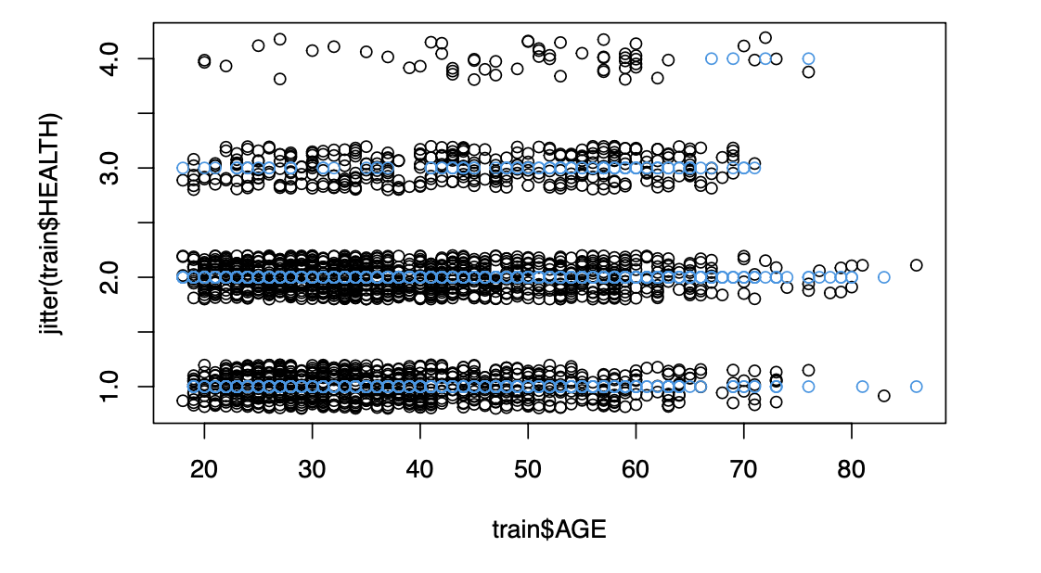
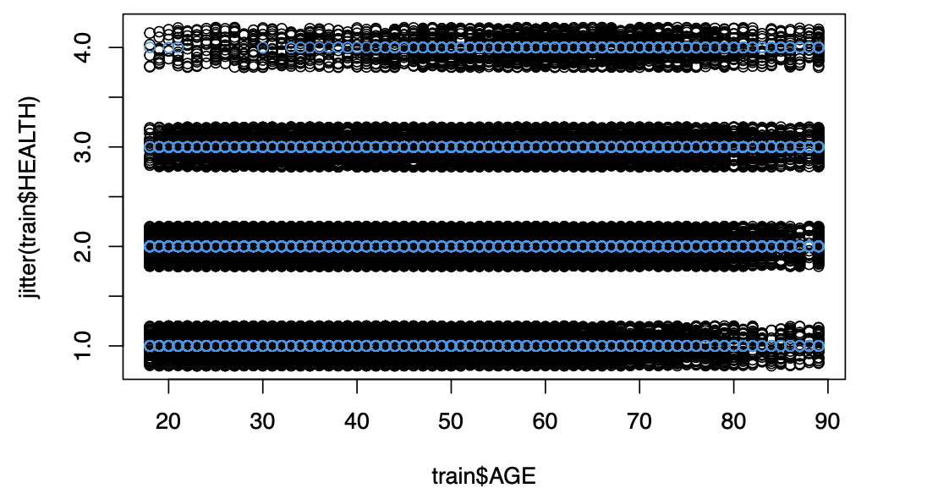
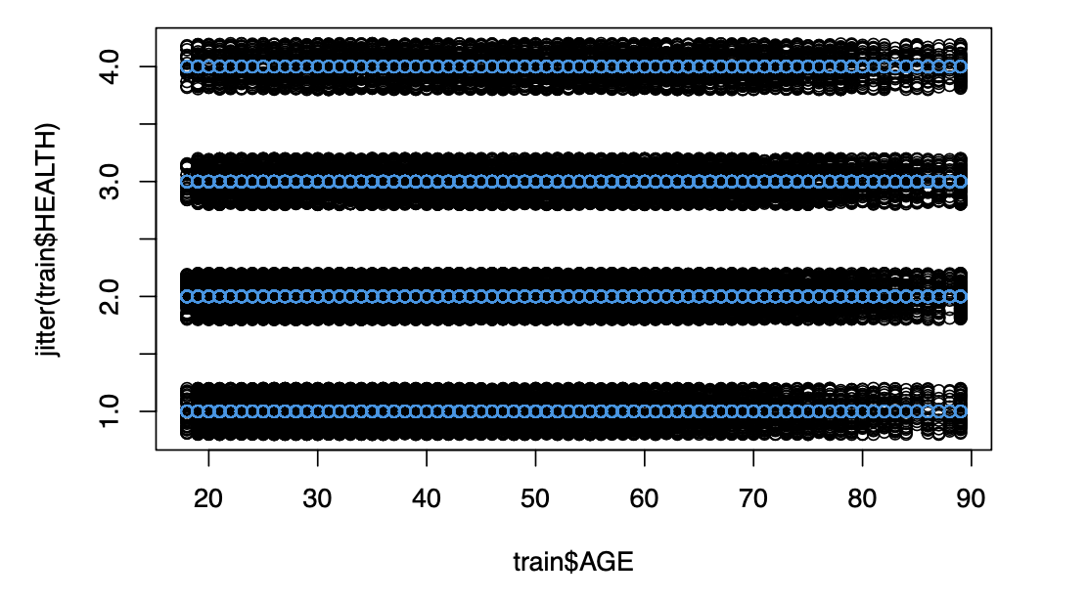
3rd Mice model
4th Mice model
Model with Complete Data set
5th Mice model
Model with r-values

Slide 13

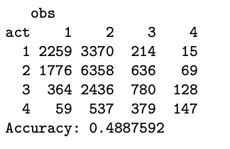
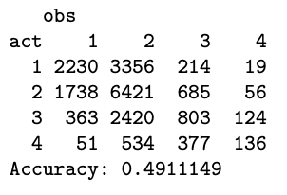
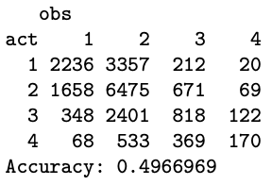
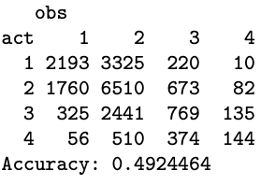
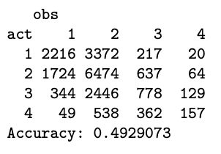
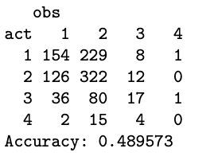
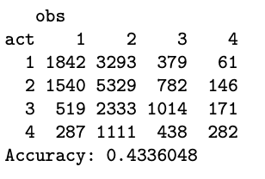
Accuracies for the Random Forest
1st Mice model
2nd Mice model
3rd Mice model
4th Mice model
5th Mice model
Model with Complete Dataset
Model with r-values
Based on the accuracy metrics 3rd Mice model gives the best results.

Slide 14
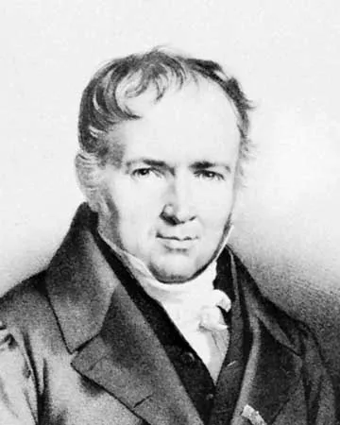
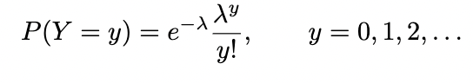
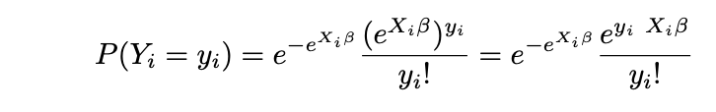
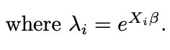
Poisson Regression
The Poisson distribution for a random variable Y has the following probability mass function:
In Poisson Regression,
We estimate p value by Chisquare distribution in Poisson regression, where in linear regression, we use t-distribution.
We get Null Deviance and Residual deviance from the poisson model
Larger the deviance represents the model does not fit very well.

Slide 15
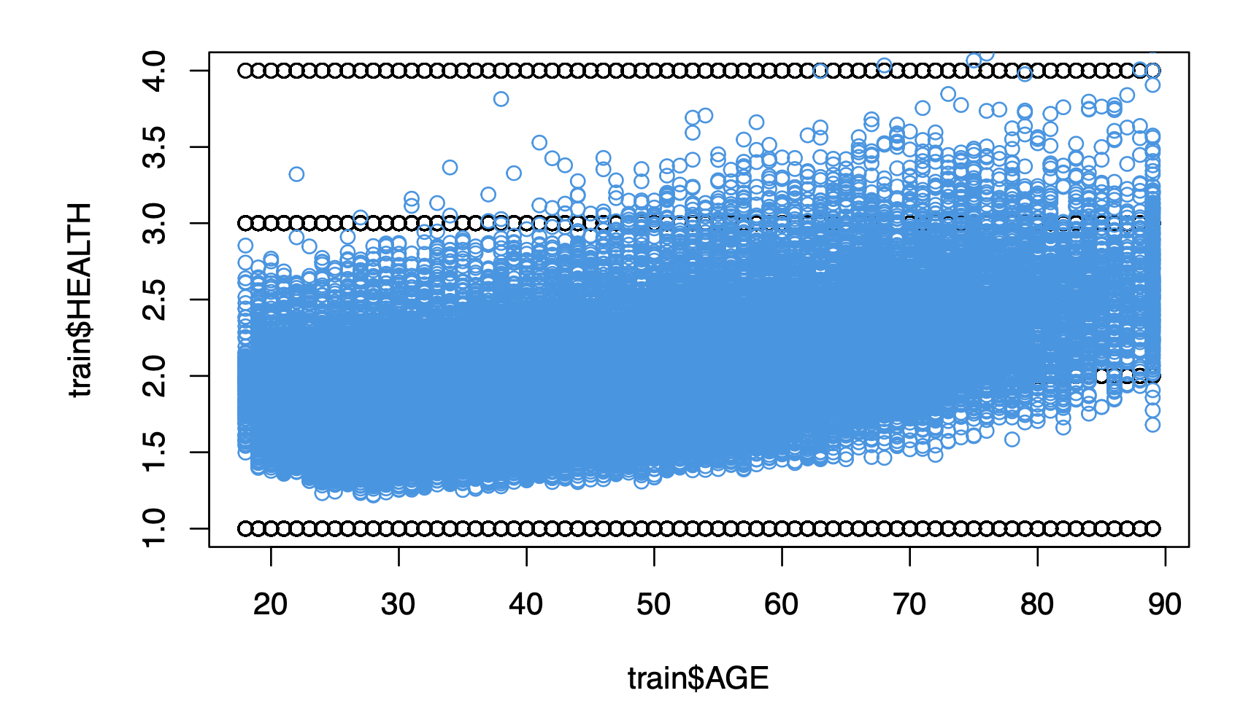
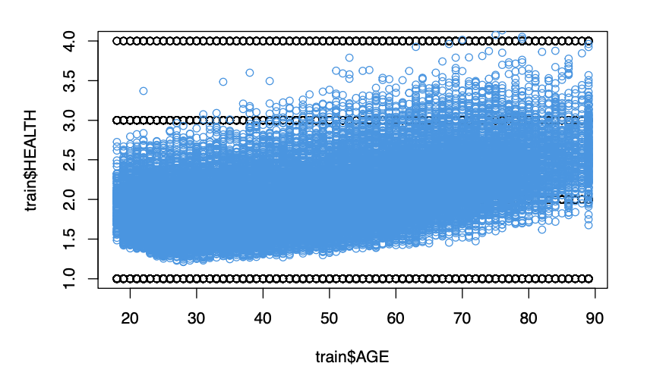
Our Model
We train this model with all 7 data sets and we get the following graphs
1st Mice model
2nd Mice model

Slide 16
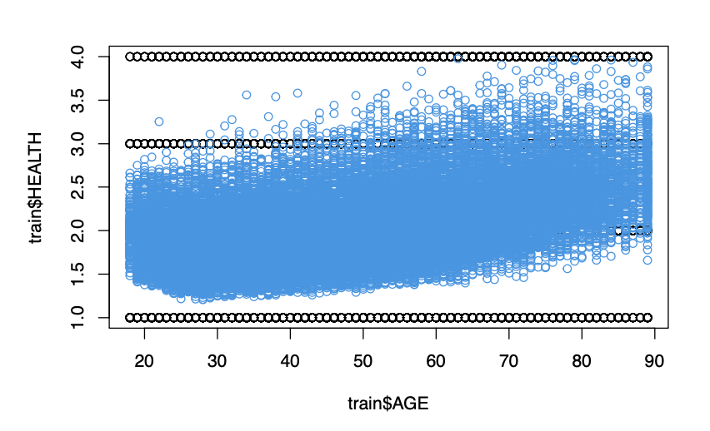
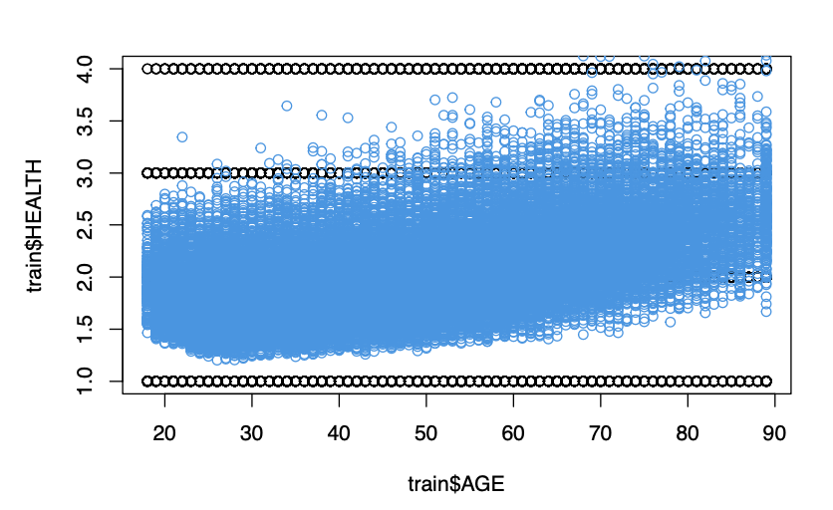
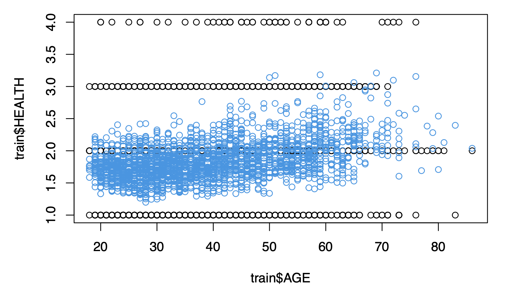
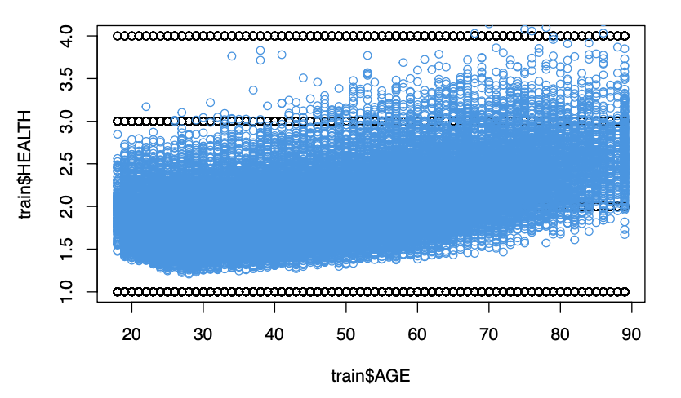
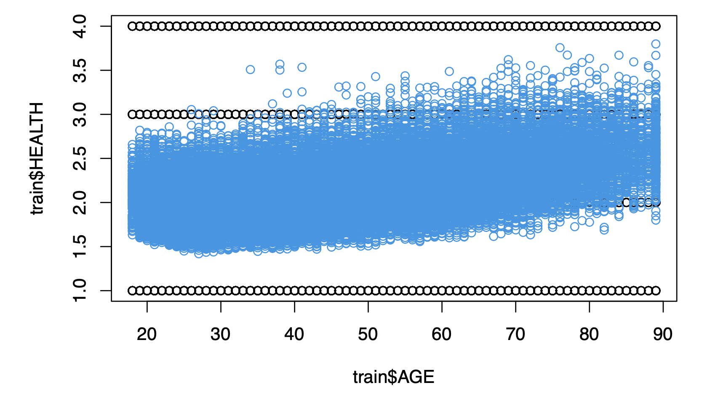
3rd Mice model
4th Mice model
Model with Complete Data set
5th Mice model
Model with r-values

Slide 17
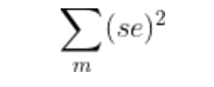
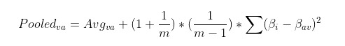
Average Beta Coefficients:
In our case, we took a scenario, instead of comparing all the 5 mice models, we thought of averaging the beta coefficients across the 5 summaries.
Average Variance:
Taking average across the 5 summaries of square of standard errors.
Pooled Variance:
It combines the variance estimates within the individual groups. It is a better estimate of the common group variance than either of the individual group variance.

Slide 18
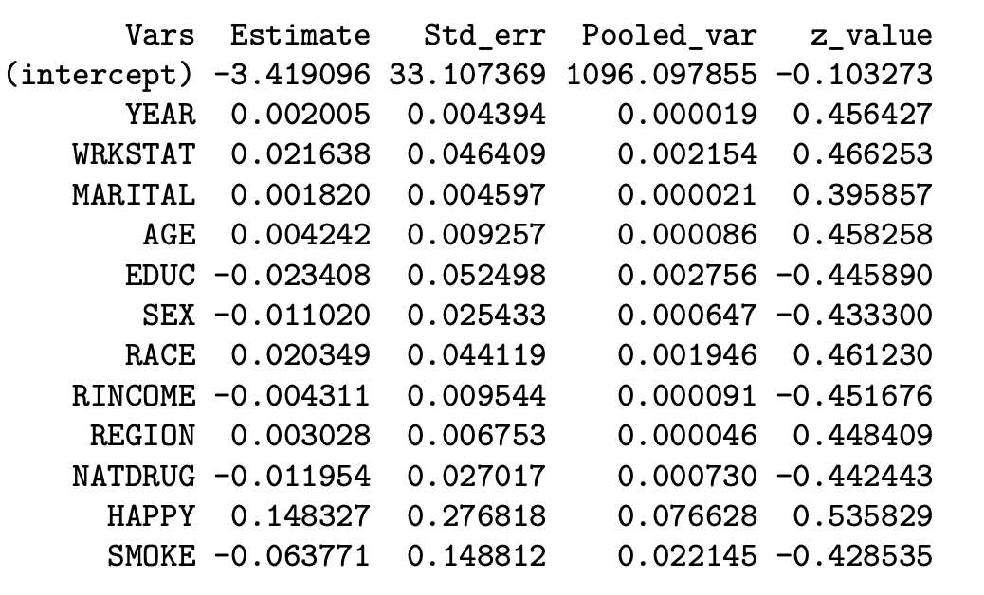
Pooled Model:

Slide 19

Conclusion:
From Poisson Regression model, we use deviance as the metric to compare the models.
Out of all the trained models, pooled model has the least null and residual deviance.
Mice method is the most effective imputing method for the NA values.
Pooled variance gives the effective variance.
Poisson Regression mainly concentrates on the count of the features.
Ensemble techniques are used to increase the accuracy and handle the unstable variance.

Slide 20

THANK YOU

